Slide 1
CAS
Creative, Activity, Service

Slide 2
What is CAS?
CAS is one of the three elements of the IB Diploma Programme core.
CAS involves students in a range of enjoyable and significant experiences, as well as a CAS Project.

Slide 3
CAS Strands
• Creativity—exploring and extending ideas leading to an original or interpretive product or performance.
• Activity—physical exertion contributing to a healthy lifestyle.
• Service—collaborative and reciprocal engagement with the community in response to an authentic need.

Slide 4
CAS begins at the start of the Diploma Programme (August of Junior year) and continues regularly, ideally on a weekly basis, for at least 18 months with a reasonable balance between creativity, activity, and service.

Slide 5
CAS
Single CAS Experience/CAS stages may/may not be used
Series of CAS Experiences/CAS Stages used
CAS Project: collaborative series of CAS Experiences/CAS stages used

Slide 6
CAS Portfolio
All students are expected to complete their CAS Portfolio in ManageBac. (https://edgewood.managebac.com) – you were emailed this account over the summer to your HCPS email
In ManageBac, students will provide the school with evidence demonstrating achievement of the seven CAS learning outcomes.
Students will submit their reflections and evidence in ManageBac

Slide 7
All CAS students are expected to …
to maintain and complete a CAS reflections as evidence of their engagement with CAS.
engage in CAS experiences involving one or more of the three CAS strands.
undertake a CAS project of at least one month’s duration
Meet four times, as a group, with CAS Coordinators: Ms. Wiland class of 2019 Ms. Hoy class of 2018.
  October-November Junior year
  February-March Junior Year
  October-November Senior Year
  February-March Senior Year

Slide 8
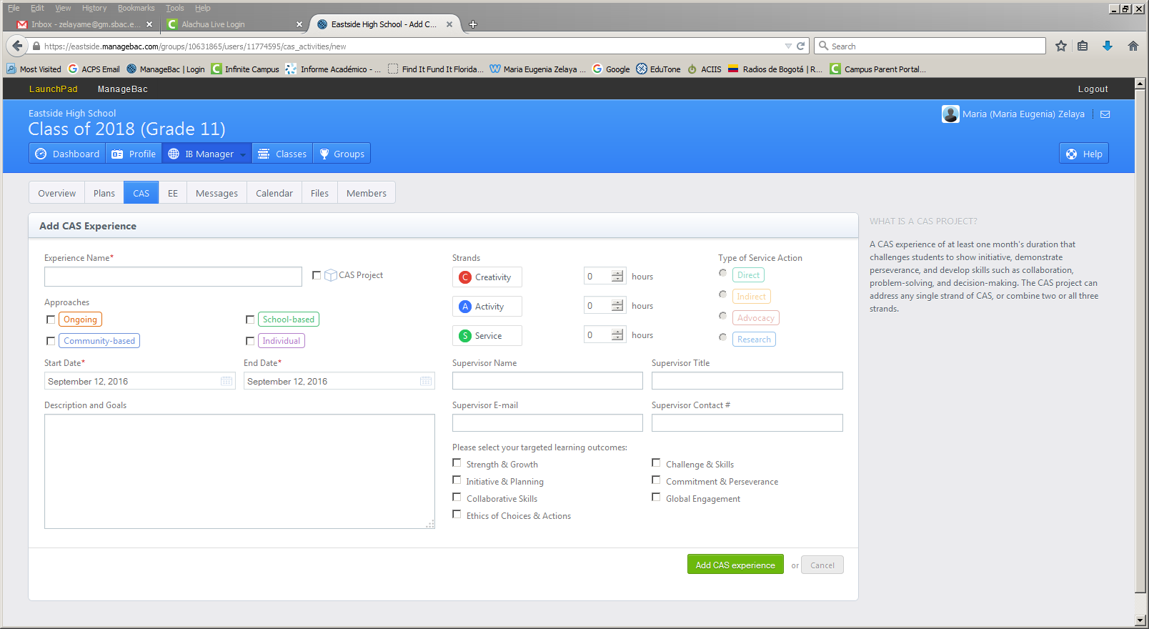

Slide 9
CAS Experiences
Approaches to creativity and activity:
  Ongoing
  School-based
  Community-based
  Individual
Approaches to service:
  Ongoing service
  School-based service
  Community-based service
  Immediate need service
  Fundraising
  International service
  Volunteerism
  Service arising from the curriculum
A CAS experience is a specific event in which the student engages with one or more of the three CAS strands
Experiences
Creativity
Activity
Service

Slide 10
CAS experiences may incorporate one or more of the CAS strands.
Going for a mountain hike could be a singular experience within the “Activity” strand.
A student plans a number of visits to a nursing home resulting in a series of CAS experiences within the “Service” strand.
A group of students plan and stage a basketball tournament for the local community, resulting in a series of CAS experiences involving the strands of “Activity” and “Service”.

Slide 11
A CAS experience must:
• fit within one or more of the CAS strands
• be based on a personal interest, skill, talent or opportunity for growth
• provide opportunities to develop the attributes of the IB learner profile
• not be used or included in the student’s Diploma course requirements

Slide 12
CAS Project
A CAS project involves collaboration between a group of students or with members of the wider community.
All CAS projects should use the CAS stages as a framework for implementation.
A CAS project can address any single strand of CAS, or combine two or all three strands.
A CAS project is a collaborative series of sequential CAS experiences lasting at least one month

Slide 13
Examples of CAS Projects
Creativity: A student group plans, designs and creates a mural in the community.
Activity: Students set up and organize and plan with Habitat for Humanity in the construction of a house.
Service: Students set up and conduct tutoring for people in need.
Creativity and activity: Students choreograph a routine for their marching band.
Service and activity: Students plan and participate in the planting and maintenance of a garden with members of the local community.
Service and creativity: Student s identify that children at a local school need back packs and subsequently design and make the backpacks out of recycled materials.
Creativity, activity, and service: Students rehearse and perform a dance production for a community retirement home.

Slide 14
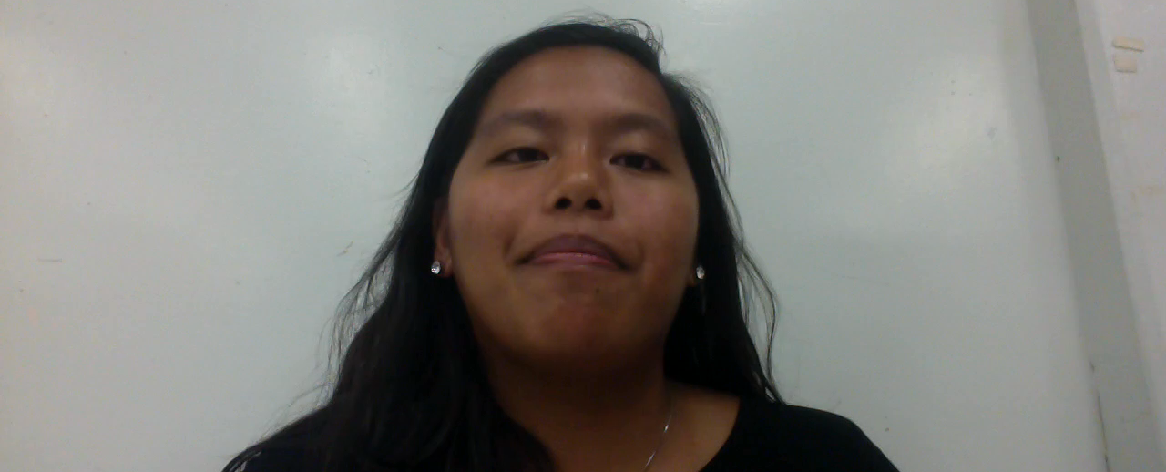
CAS Project (Example)

Slide 15
CAS Stages
1. Investigation:
2.Preparation: Students clarify roles and responsibilities, develop a plan of actions to be taken, identify specified resources and timelines, and acquire any skills as needed to engage in the CAS experience.
3.Action: Students implement their idea or plan. This often requires decision-making and problem- solving. Students may work individually, with partners, or in groups.
4. Reflection: Students describe what happened, express feelings, generate ideas, and raise questions.
5. Demonstration: Students make explicit what and how they learned and what they have accomplished, for example, by sharing their CAS experience through their CAS reflections

Slide 17
Reflection
Reflection is a dynamic means for self-knowing, learning and decision-making. Four elements assist in the CAS reflective process.
  Describe what happened
  Expressing feelings
  Generating ideas
  Asking questions

